Slide 1
Computer Organization and Architecture (BESE-15a)
Dr. HammaD AfzaL
Dept. of Computer Science
Hammad.afzal@mcs.edu.pk
15th&20th /12/2010

Slide 2
Internal Memory From Computer Organization and Architecture William Stallings- 7th Edition

Slide 3
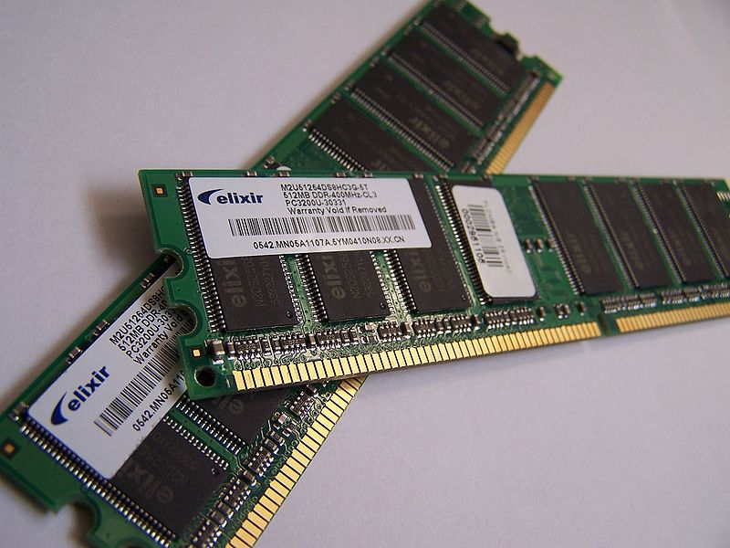
Example of writable volatile random-access memory: Synchronous Dynamic RAM modules, primarily used as main memory in personal computers, workstations, and servers.

Slide 4
Random Access Memory
Random-access memory (RAM) is a form of computer data storage. Today, it takes the form of integrated circuits that allow stored data to be accessed in any order (i.e., at random). "Random" refers to the idea that any piece of data can be returned in a constant time, regardless of its physical location and whether it is related to the previous piece of data.

Slide 5
RAM
The word "RAM" is often associated with volatile types of memory (such as DRAM memory modules), where the information is lost after the power is switched off. Many other types of memory are RAM as well, including most types of ROM

Slide 6
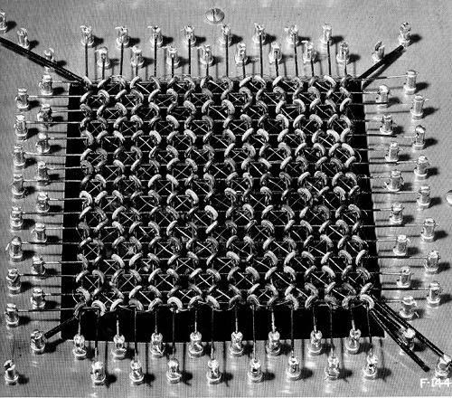
Cores – Self Study

Slide 7
Core – Self Study
Core Dump
After it's creation in 1952, core memory remained the fastest form of memory available until the late 1980's. Core memory (also known as main memory), is composed of a series of donut-shaped magnets, called cores. The cores were treated as binary switches. Each core could be polarized in either a clockwise or counterclockwise fashion, thus altering the positive or negative charge of the "donut" changed it's state. Until fairly recently, core was the prominent form of memory for computing (by 1976, 95% of the worlds computers used core memories). It had several features that made it attractive for computer hardware designers. First, it was cheap. Dirt cheap. In 1960, when computers were beginning to be widely used in large commercial enterprises, core memory cost about 20 cents a bit. By 1974, with the wide-spread use of semi-conductors in computers, core memory was running slightly less than a penny per bit. Secondly, since core memory relied on changing the polarity of ferrite magnets for retaining information, core would never lose the information it contained. A loss of power would not effect the memory, since the states of the magnets wouldn't be changed. In a similar vein, radiation from the machine would have no effect on the state of the memory. Core memory is organized in 2-dimensional matrices, usually in planes of 64X64 or 128X128. These planes of memory (called "mats") were then stacked to form memory banks, with each individual core barely visible to the human eye.. The core read/write wires were split into two wires (column, row), each wire carrying half of the necessary threshold switching current. This allowed for the addressing of specific memory cores in the matrix for reading and writing.

Slide 8
Semiconductor Memory Types
Memory Type | Category | Erasure | Write Mechanism | Volatility
Random-access memory (RAM) | Read-write memory | Electrically, byte-level | Electrically | Volatile
Read-only memory (ROM) | Read-only memory | Not possible | Masks | Nonvolatile
Programmable ROM (PROM) |  |  | Electrically
Erasable PROM (EPROM) | Read-mostly memory | UV light, chip-level
Electrically Erasable PROM (EEPROM) |  | Electrically, byte-level
Flash memory |  | Electrically, block-level

Slide 9
Semiconductor Memory
RAM
Misnamed as all semiconductor memory is random access (refer previous table)
Read/Write
are easy and accomplished using electric signals.
Volatile
Must be provided with constant power supply
Temporary storage
Types
Static or dynamic

Slide 10
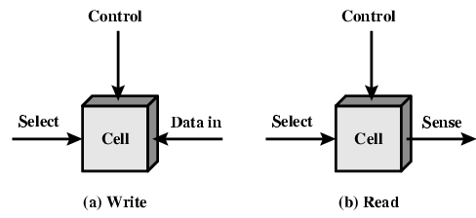
Memory Cell Operation

Slide 11
Memory Cell Operation
They exhibit two stable states, to represent binary 0 and 1.
They are capable of being written into (at least once) to set the state
They are capable of being read to sense the state.

Slide 12
Memory Cell Operation
Three functional terminals capable of carrying an electrical signal.
Select
Control
Data
The details of internal organization, functioning and timing of memory cell depend on the specific integrated circuit technology and are beyond the scope of this course.

Slide 13
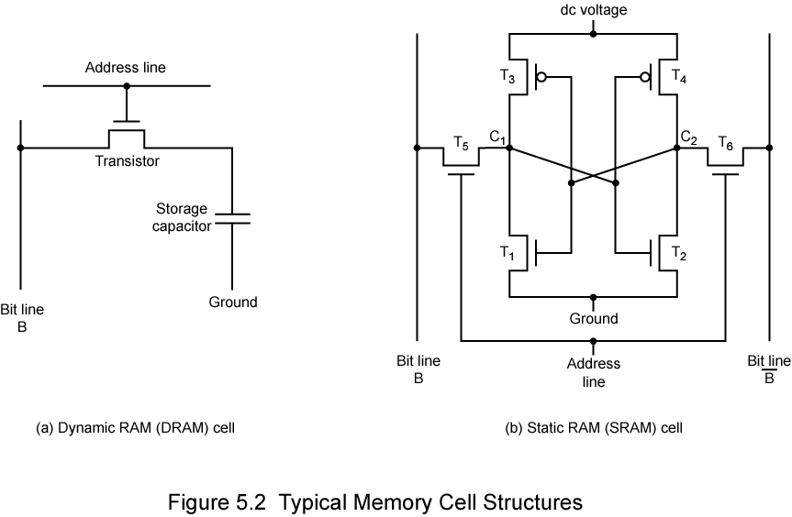
Dynamic RAM
Data
Bits stored as charge in capacitors. Presence and absence of charge represents 1 and 0 respectively.
Charges leak
Need refreshing even when powered
Simpler construction
Smaller per bit
Less expensive
Need refresh circuits
Slower
Main memory
Essentially analogue
Level of charge determines value

Slide 14
DRAM Operation
Address line active when bit read or written
Transistor switch closed (current flows)
Transistor switch open (current doesn’t flow)
Write
Voltage to bit line
High for 1 low for 0
Then signal address line
Transfers charge to capacitor
Read
Address line selected
transistor turns on
Charge from capacitor fed via bit line to sense amplifier
Compares with reference value to determine 0 or 1
Capacitor charge must be restored
Analog Device
Capacitor can store any charge value within a range, a threshold value will be used to interpret it.

Slide 15
Static RAM
Bits stored as on/off switches
Four transistors, crossed connected, to produce stable logic state.
More complex construction
No charges to leak
No refreshing needed when powered (dc voltage)
Larger per bit
More expensive
Faster
Cache
Digital Device
Uses flip-flops

Slide 16
Static RAM Operation (Details out of scope – May study in BEE course)
Transistor arrangement gives stable logic state
State 1
C₁ high, C₂ low
T₁ T₄ off, T₂ T₃ on
State 0
C₂ high, C₁ low
T₂ T₃ off, T₁ T₄ on
Address line transistors T₅ T₆ is switch
Write – apply value to B & compliment to B
Read – value is on line B

Slide 17
SRAM v DRAM
Both volatile
Power needed to preserve data
Dynamic cell
Advantages
Simpler to build, smaller
More dense (more cells per unit area)
Less expensive
Disadvantages
Needs refresh
Used for Larger memory units (Main Memory)
Static
Faster
Expensive
Used for Cache

Slide 18
Why Static Ram is Faster
In terms of speed, Static RAM(SRAM) is faster. Dynamic RAM(DRAM) needs to be refreshed thousands of times per second while Static RAM does not need to be refreshed, which is what makes it faster than Dynamic RAM*.
*http://wiki.answers.com/Q/Is_SRAM_or_DRAM_faster

Slide 19
Read Only Memory (ROM)
Permanent storage
Nonvolatile
Can read but not write
Applications
Microprogramming (see later)
Library subroutines
Systems programs (BIOS)
Data and Programs are continuously in Main memory and never be loaded from a secondary storage device.

Slide 20
Types of ROM
ROM
Written during manufacture
Very expensive for small runs (Data insertion step)
No room for error (if 1 bit is wrong, whole batch of ROMs will be thrown out)
When a small number of ROMs with a particular memory content is needed, we can use PROM
Programmable (once)
PROM
Not written at fabrication time.
Needs special equipment to program
Flexible and convenient

Slide 21
Types of ROM
When a more read and less writes are required, but non-volatile storage is required
Read “mostly”
Erasable Programmable (EPROM)
Erased by UV – light fitted in memory chip –
Expensive than PROM
Takes 20 mins. All cells shall be brought to initial state.
Electrically Erasable (EEPROM)
Takes much longer to write than read
Can be read/write any time without erasing prior contents, only the bytes addressed are updated.
Flash memory
Named after its speed.
Can erase whole memory electrically in few seconds.
A portion (block) of memory are erased in one flash. Hence the name.
Doesn’t provide byte level erasure.
1 transistor per chip = High density

Slide 22
Memory Organization
Trade-offs
One extreme: Physical arrangement same as perceived by Processor.
A 16Mbit chip can be organised as 1M of 16 bit words
Other extreme: One bit per chip;
A bit per chip system has 16 lots of 1Mbit chip with bit 1 of each word in chip 1 and so on
ROM organization is similar.

Slide 23
Organisation in detail
A typical organization of 16Mbit chip. 4 bits are read/write at a time.
Logically, 4 square arrays of 2048 by 2048 elements. Therefore, A 16Mbit chip can be organised as a 2048 x 2048 x 4bit array
Reduces number of address pins
Multiplex row address and column address
11 pins to address (2¹¹=2048)
Adding one more pin doubles range of values so x4 capacity

Slide 24
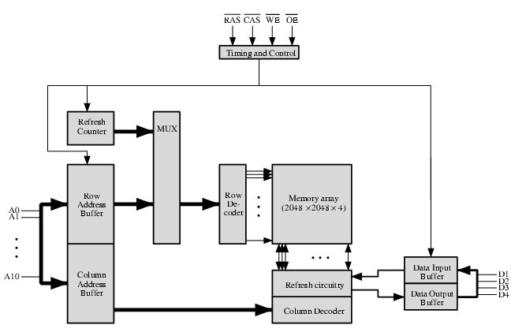
Typical 16 Mb DRAM (4M x 4)

Slide 25
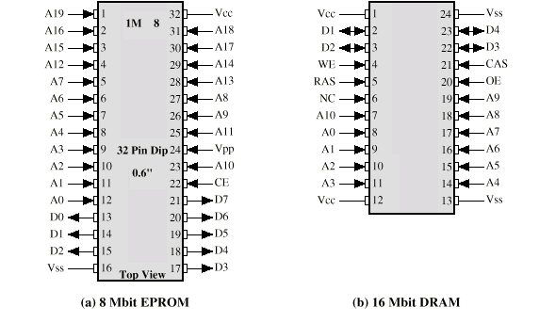
Packaging

